Slide 1



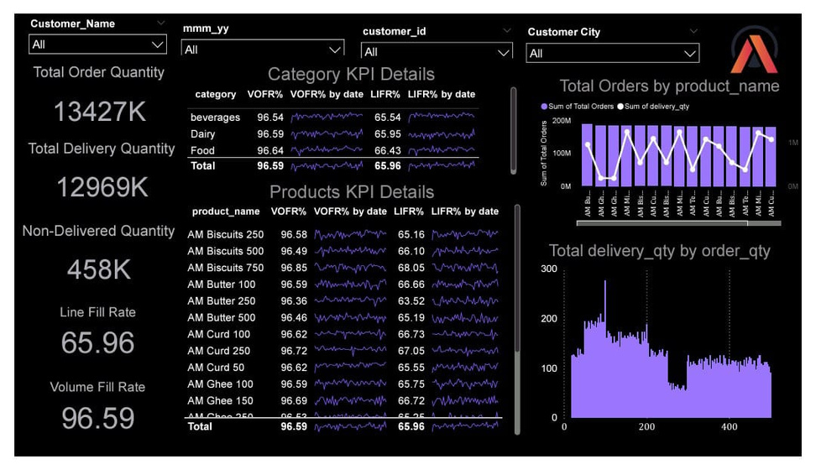
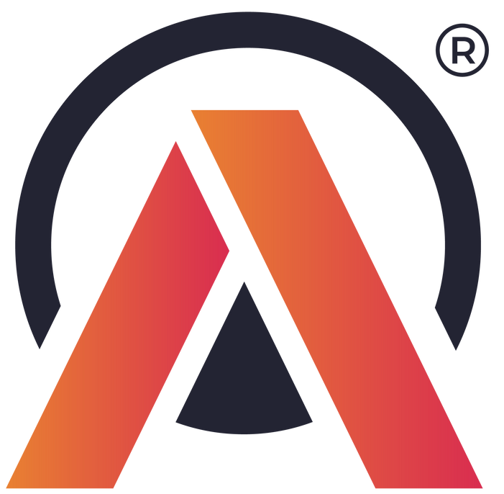
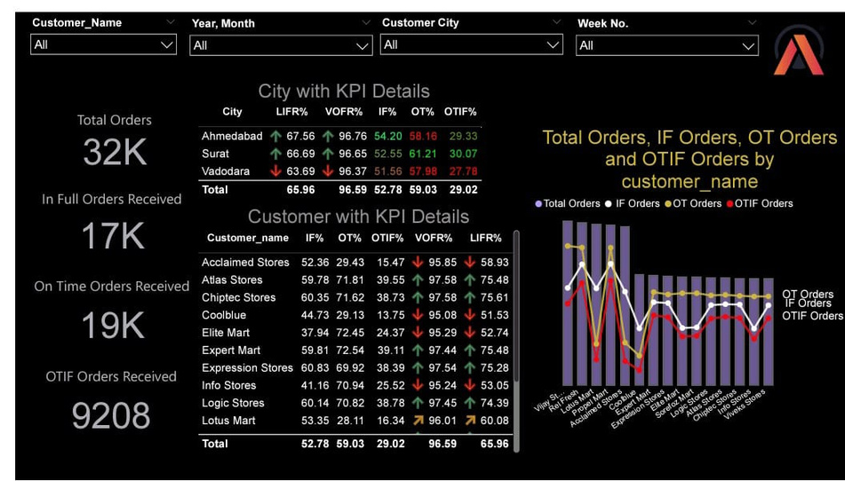
ATLIQ MART
Supply Chain Report

Slide 2

About Atliq Mart

Slide 3


Atliq Mart
Atliq Mart is growing FMCG manufacturer headquartered in Gujarat, India. It is currently operational in three cities Surut, Ahmedabad and Vadodra

Slide 4
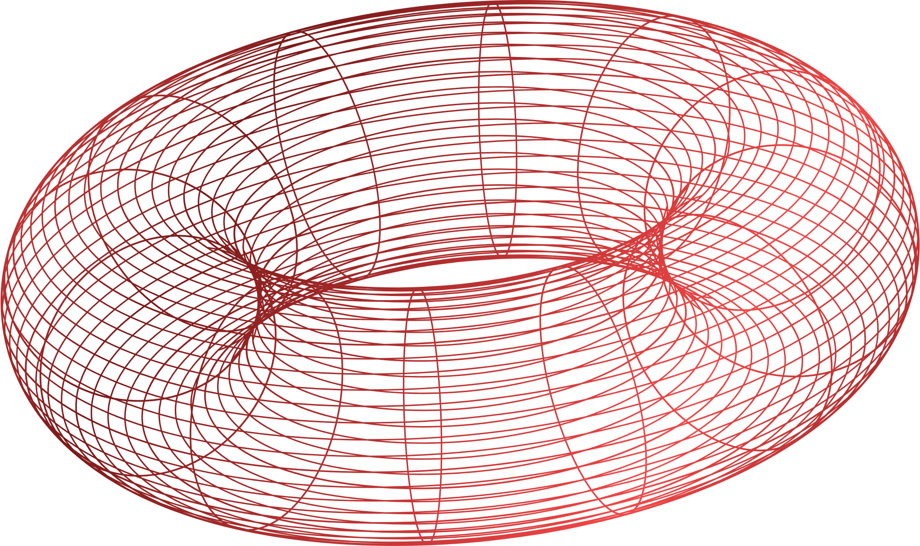
Problem Statement:
Atliq Mart want to expand to other metro cities in the next 2 years.
Atliq Mart is currently facing a problem where a few key customers did not extend the annual contract due to service issues. It is speculated that some of the essential products were either not delivered on time or not delivered in full over a continued period, which could have resulted in bad customer service. Management wants to fix this issue before expanding to other cities and requested their supply chain analytics team to track the ‘On time’ and ‘In Full’ delivery service level for all the customers on a daily basis so that they can respond swiftly to these issues.

Slide 5

On-Time-Delivery (OT%) = (Total Orders delivered on time)/(Total number of orders)
In-Full-Delivery (IF%) = (Total Orders delivered in full quantity)/ (Total number of orders)
On-Time-In-Full Delivery (OTIF%) = (Total number of orders delivered completely on time)/(Total number of orders)
Line Fill Rate (LIFR%) = (Total number of lines delivered in full quantity) /( Total lines)
Volume fill Rate (VOFR%) = (Total lines delivered)/ (Total lines ordered)
Key Metrics

Slide 6



Slide 7

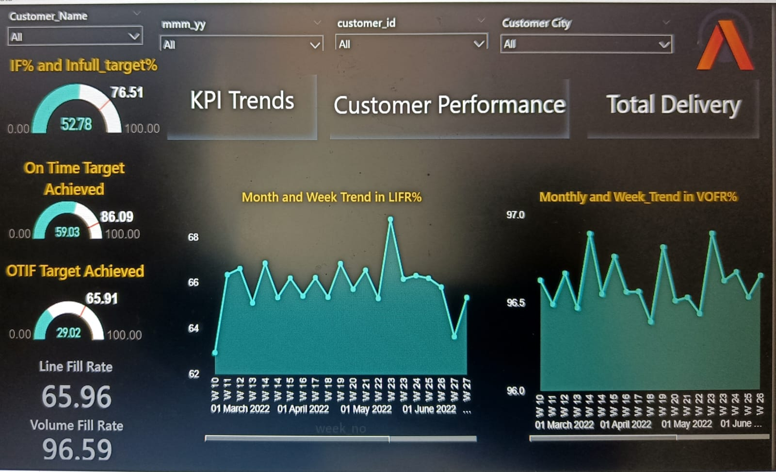
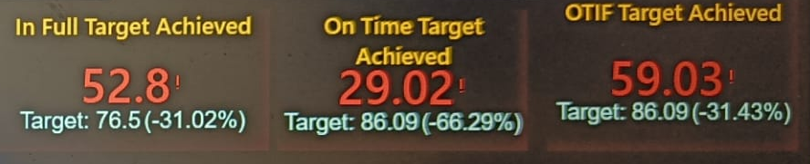
Actual vs “In Full” Target
10 Billion
There has never been an instance of Atliq Mart meeting
Its “In Full” Target.
5 Billion
1 Billion

Slide 8

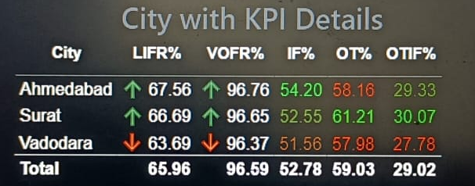
2023
City Analysis
In Ahmedabad, the gap between actuals and targets is the “Highest in On Time”, the “Lowest in In Full”
2024
.

Slide 9

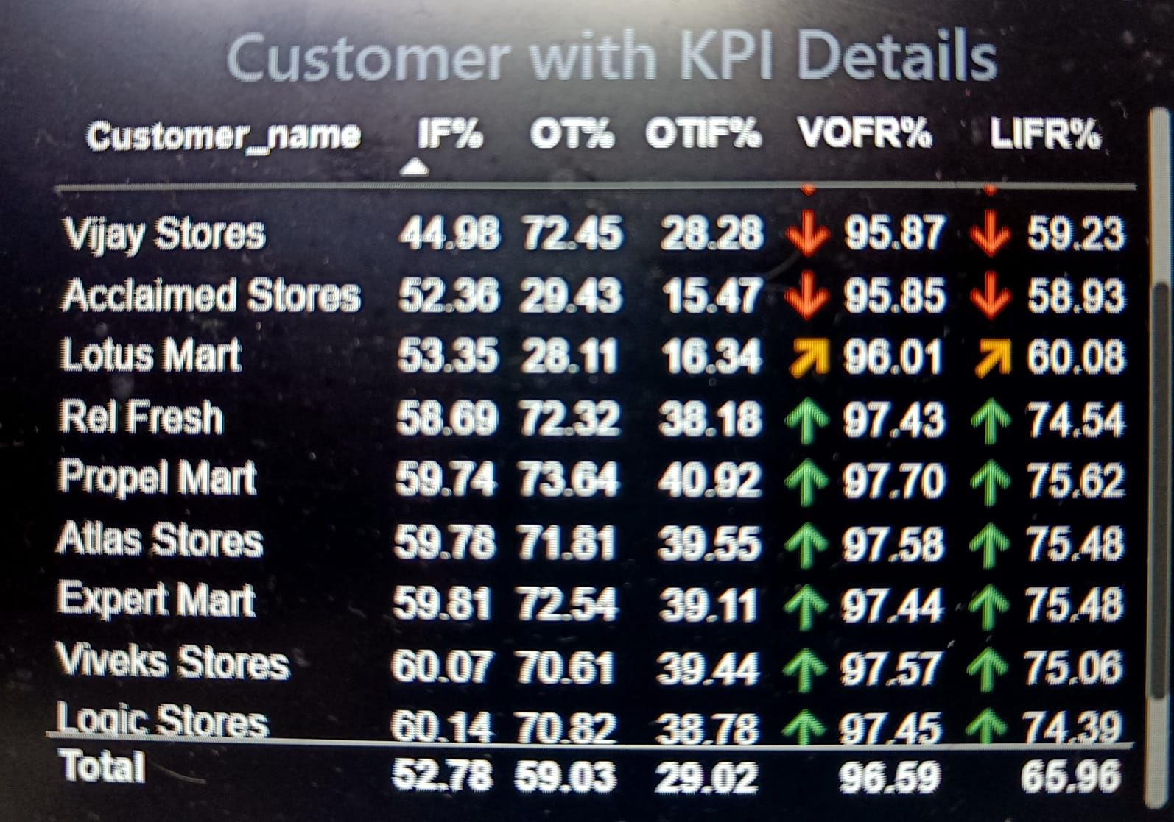

Customer Analysis
Lotus Mart Acclaimed Stores Vijay Stores Rel Fresh
Atliq Marts service is not reasonable even though these customers place large orders

Slide 10
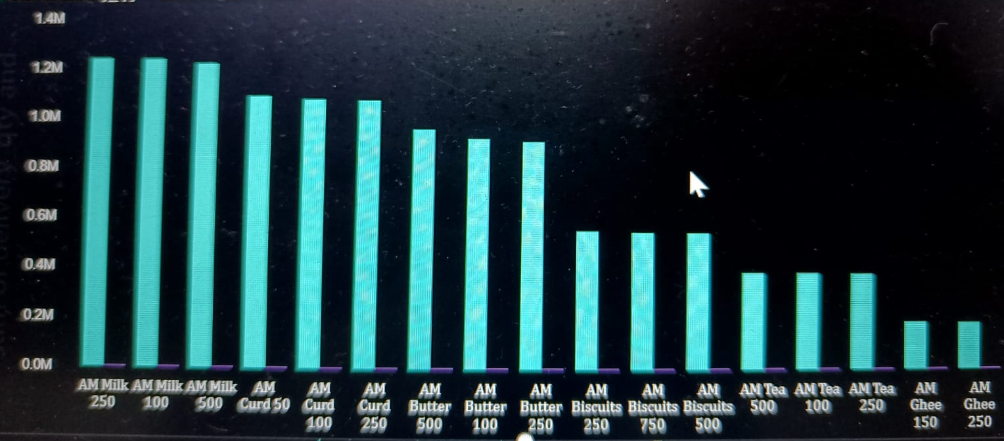
Product Analysis
Milk, curds, and butter are among the most requested products, but their availability tends to be low relative their demand

Slide 11

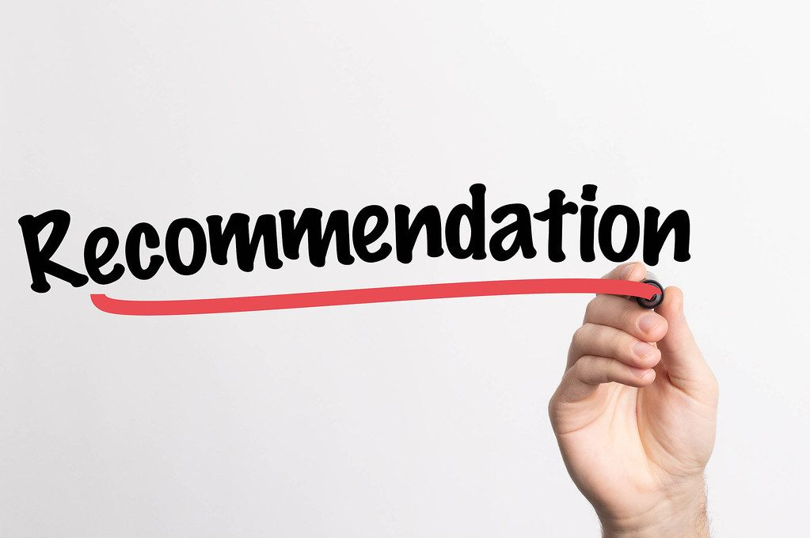
[1] – To develop a plan for safety stock
-Safety stock acts as a buffer amount that accounts for uncertainties such as: Excess demand, Suppliers delays, Inaccurate demand or inventory forecasts, Failure to place timely reorders, and Financial constraints.
-Safety stock mitigates the risks and consequences of stockouts, allowing your supply chain to proceed as usual even after cycle stock runs out.
[A] - Observing that Atliq Mart’s
product availability is always in short
[2] – To use the most effective demand forecasting model possible
-In other words, it is the process of estimating future customer demand over a certain period of time.
-Generally, demand forecasting considers historical data and other analytical information to produce the most accurate predictions.

Slide 12
[1] – Investigate the reasons for the shortage of materials.
-It may be the cause of late deliveries as products are not available.
-If it is the reason for the delay in delivery, following my previous suggestion for short supply will resolve the problem.
[A] - Observing that Atliq Mart’s
does not meet its delivery deadlines most of the time
[2] – There is always room for improvement when it comes to scheduling and planning deliveries.
-I

Slide 13
a
Thank you
EMAIL | arshisiddiqui355@gmail.com

